Slide 1
Mathematics for electronics engineers (UE21EC241A) PROJECT

Slide 2
TOPIC:WEIBULL DISTRIBUTION-AND APPLICATIONS
PROFESSOR : RAJINI M.
AKASH RAVI BHAT(PES1UG21EC025)
A.ANIRUDH SIMHA(PES1UG21EC001)
SECTION: A

Slide 3
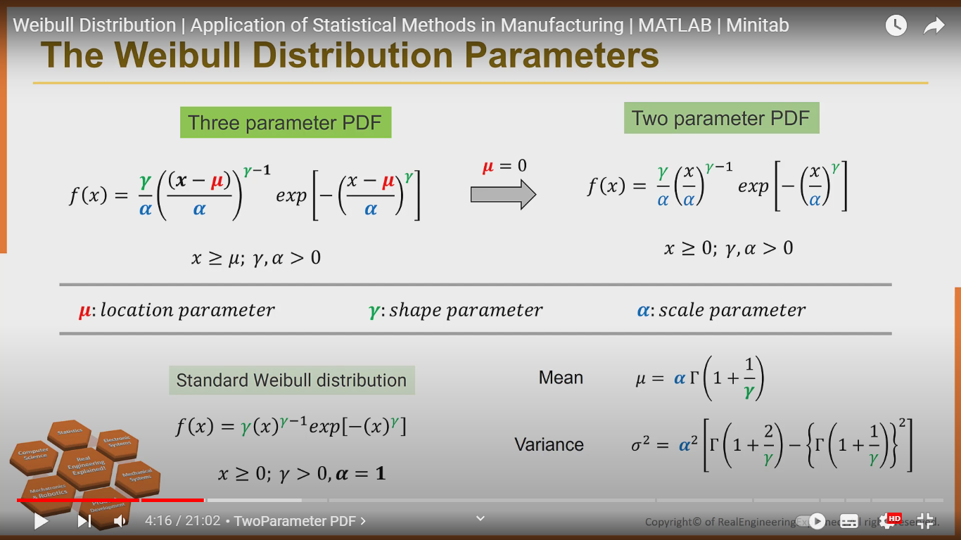

Slide 4
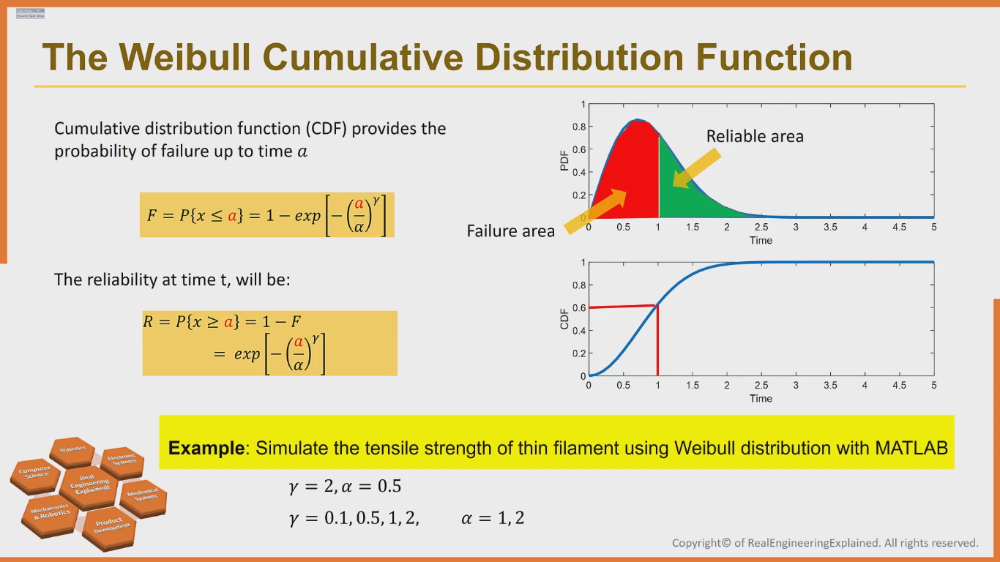

Slide 5
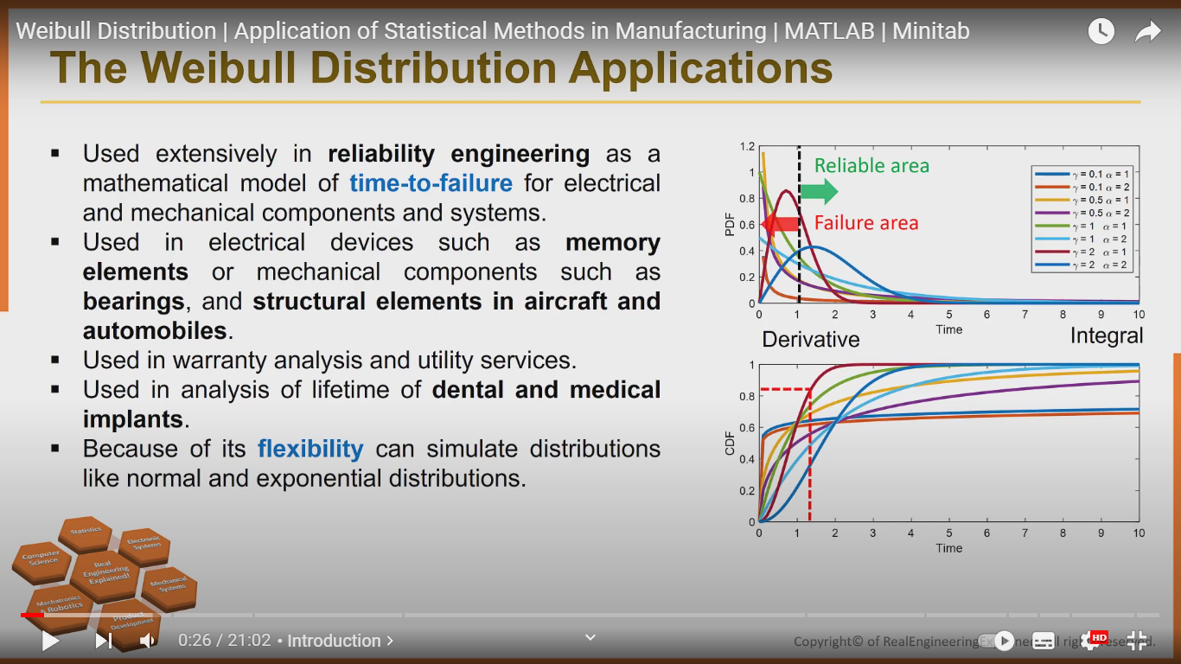

Slide 6
MATLAB IMPLEMENTATION
Example 1: Find:
P(x>20000)
P(x<10000)
P(10000<x<20000)
Expected time to failure
Given gamma=0.5 and alpha=5000
Solution:
%% Example Flat display
clc; clear;
alpha= 5000; gamma= 0.5;
p20k_below= wblcdf(20000, alpha, gamma)
p20k_beyond = 1- p20k_below
p10k_20k = wblcdf (20000, alpha, gamma) - wblcdf (10000, alpha, gamma)
[M, V]= wblstat (alpha, gamma)
time= 1:100:25000;
subplot (211); fx= wblpdf (time, alpha, gamma);
plot (time, fx, 'linewidth', 2.5); xlabel('Time'); ylabel('Weibull PDF Display');
subplot (212); ft= wblcdf (time, alpha, gamma);
plot (time, ft, 'linewidth', 2.5); xlabel('Time'); ylabel('Weibull CDF Display');

Slide 7
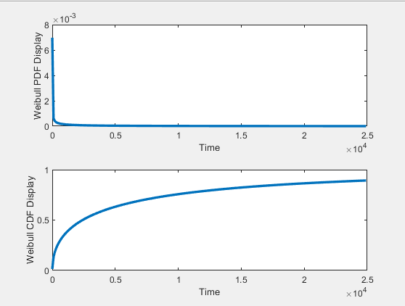
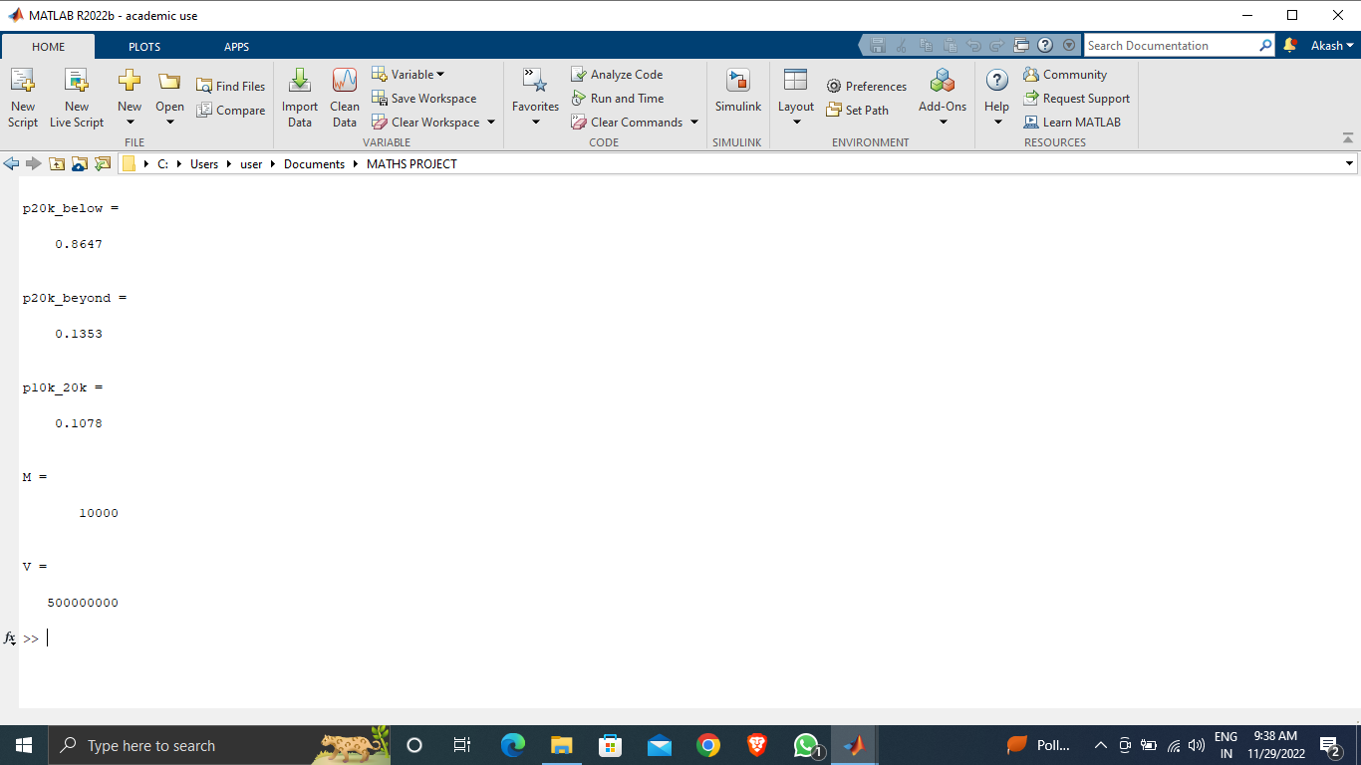
MATLAB IMPLEMENTATION
output: The graphs of CDF and PDF are obtained
we see that 10000 hour is mean failure time .

Slide 8
MATLAB IMPLEMENTATION
Example 2
Given 20000 tyres what percentage of tyres fail before running 6000km.
Alpha=5000 gamma=3.5
Solution:
%% Example Tire Weibull Distribution
clc; clear;
alpha = 5000; gamma = 3.5;
TotalTires= 20000;
y= wblcdf (6000, alpha, gamma)
FailTires= y*TotalTires
time =1:10:10000;
subplot (211); fx = wblpdf (time, alpha, gamma);
plot (time, fx, 'linewidth', 2.5); xlabel('Time'); ylabel('Weibull PDF Tire');
subplot (212); ft = wblcdf (time, alpha, gamma);
plot (time, ft, 'linewidth', 2.5); xlabel('Time'); ylabel('Weibull CDF Tire');

Slide 9
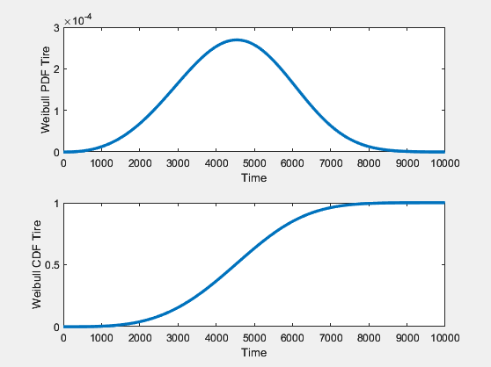
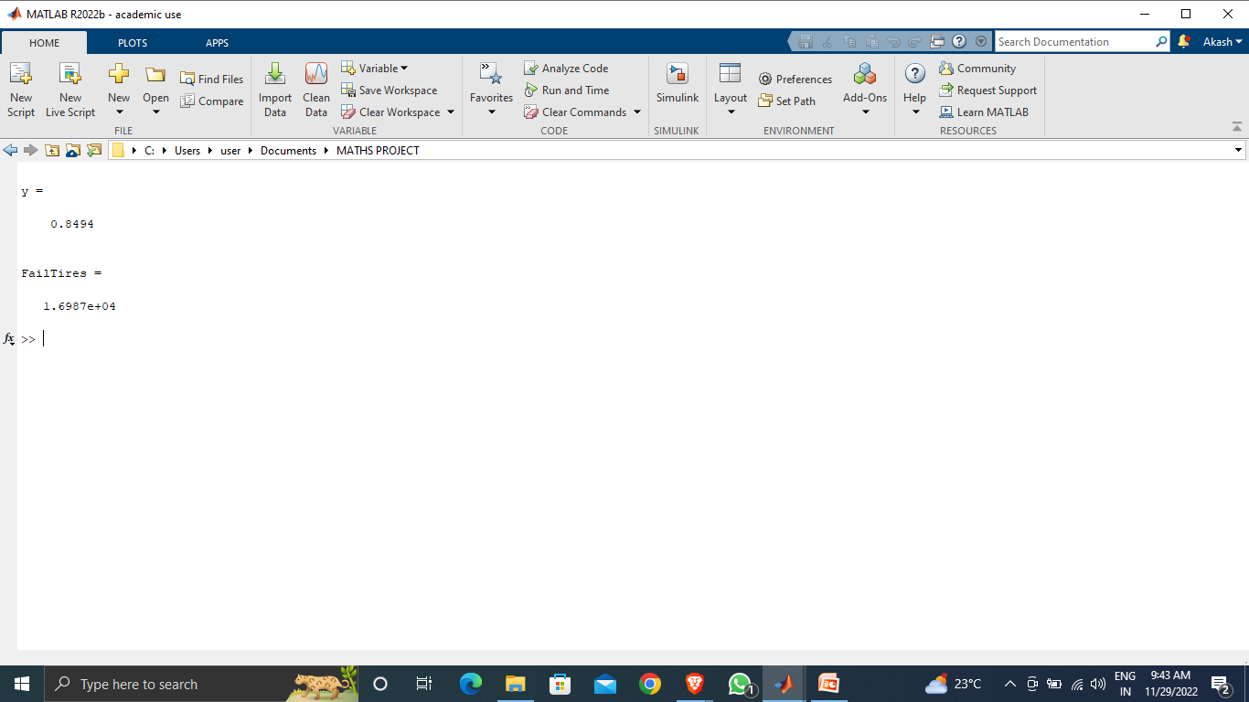
MATLAB IMPLEMENTATION
output:
we see that 85% of the tyres fail before 6000km
which is 16987 of 20000 tyres.

Slide 10
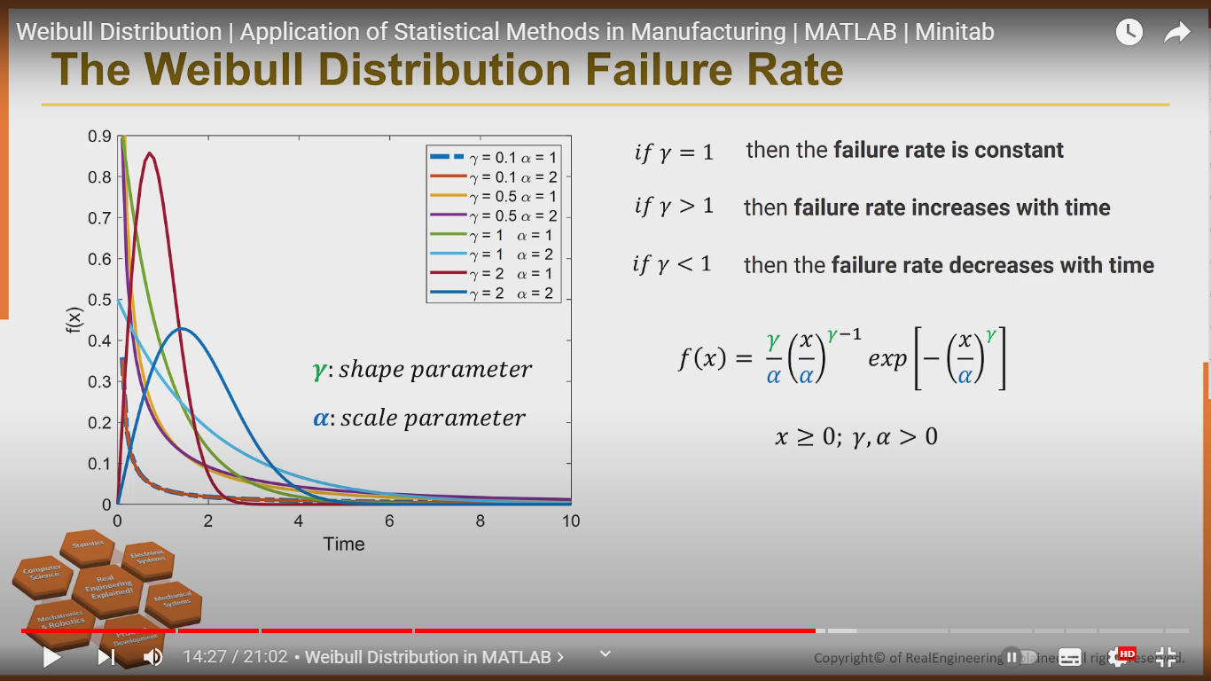

Slide 11
FEW MORE APPLICATIONS:
In survival analysis
In reliability engineering and failure analysis
In electrical engineering to represent overvoltage occurring in an electrical system
In industrial engineering to represent manufacturing and delivery times
In extreme value theory
In weather forecasting and the wind power industry to describe wind speed distributions, as the natural distribution often matches the Weibull shape In communications systems engineering
In radar systems to model the dispersion of the received signals level produced by some types of clutters
To model fading channels in wireless communications, as the Weibull fading model seems to exhibit good fit to experimental fading channel measurements
REFERENCE:
https://en.wikipedia.org/wiki/Weibull_distribution

Slide 12
THANK YOU

